Slide 1
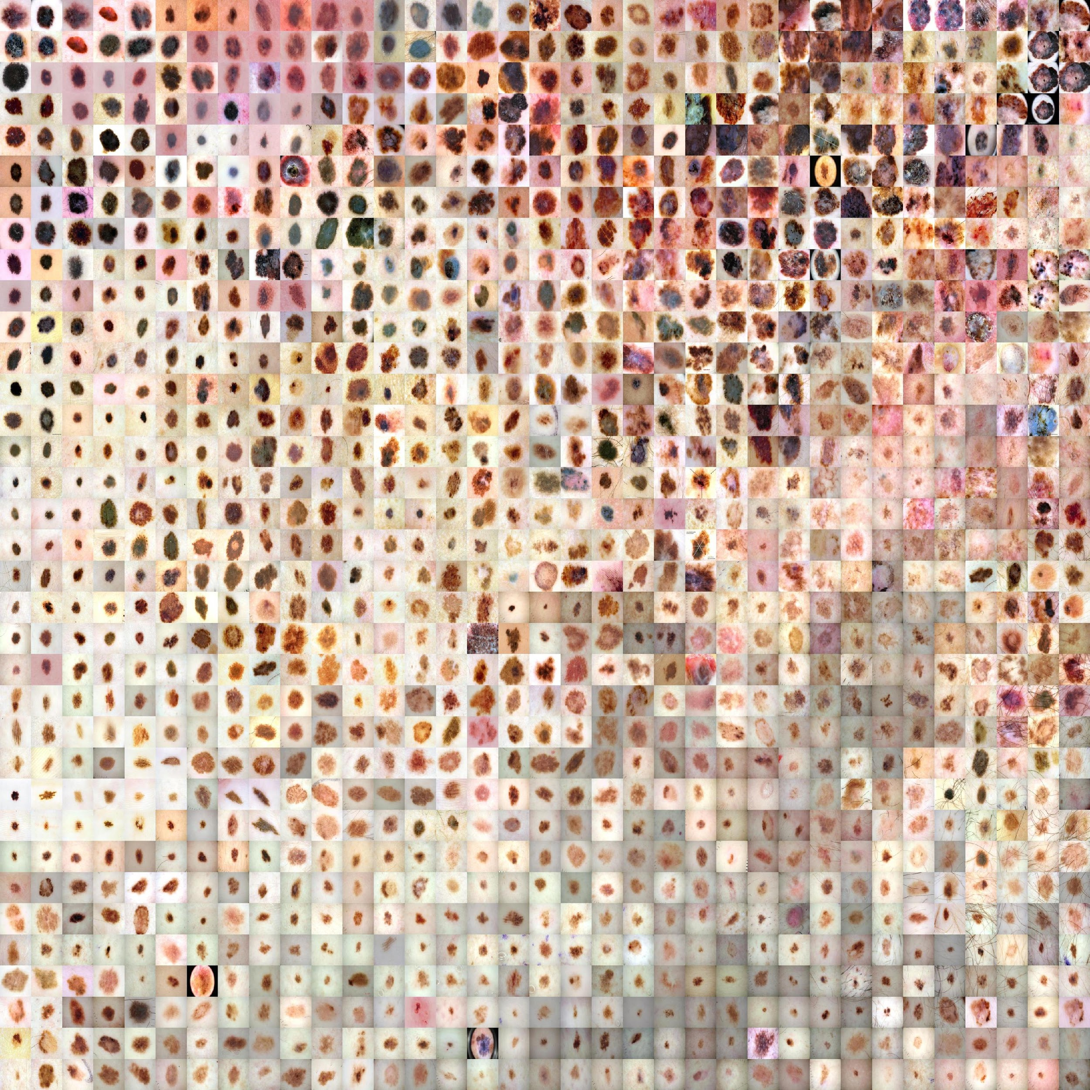
Machine Learning for Automated Diagnosis of Skin Lesions
Student: Fábio Santos Nº80317
Supervisors: Filipe Silva, Pétia Georgieva
Seminar, Aveiro University, 11/12/2019

Slide 2
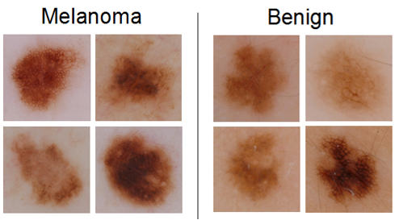
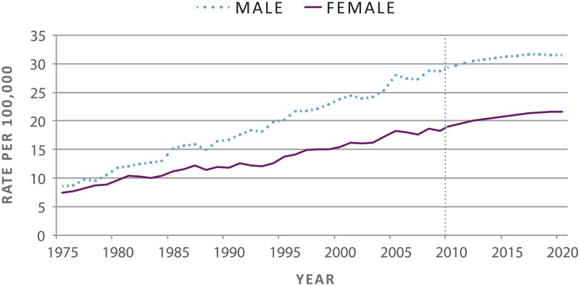
Context and Objectives
Skin cancer is the most common type of cancer (1 in 5 persons)
When detected on late stages survival rates are 23%
When detected early survival rates are 99%!
Skin lesions can be difficult to classify even for dermatologists
Support decision tool for automated diagnosis of skin lesions are needed
eHealth/mHealth app which integrates well into the clinical workflow
Fig 1 - Melanoma vs benign moles [1]
Fig 2 - Melanoma incidence rates [2]

Slide 3
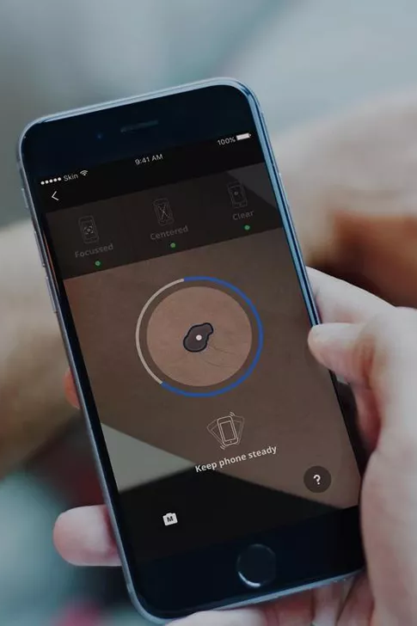
Fig 3 - SkinVision mHealth app [3]
Deep learning in medical imaging
Advantages over other Ml methods:
No feature engineering
Transfer learning
Rise of deep learning due to:
New methods to prevent overfitting
Rise of computing power along with GPU usage
High level modules to build neural nets
Applied in contexts such as:
Diabetic retinopathy
Diagnosis of breast nodules
Used as support tool in eHealth/mHealth apps
Can beat human performance

Slide 4

Deep learning for skin lesion diagnosis (transfer learning)
“Dermatologist-level classification of skin cancer with deep neural networks”, by Esteva et al. in 2017 [4]:
Most famous result in skin lesion classification using deep learning
Labelled skin images from multiple sources totalling 129450 samples!
Used data augmentation
Transfer learning approach (InceptionV3 trained on ImageNet)
Evaluated against 21 board-certified dermatologists
AUC: 0.96
“Man against machine”, by Haenssle et al, in 2018 [5]:
Similar approach to Esteva et al but with less data
Evaluated against 58 dermatologists!
AUC: 0.86
Most approaches use transfer learning
Fig 4 - Nature’s front page [4]

Slide 5
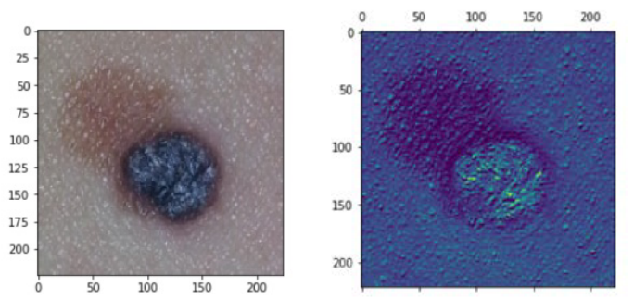
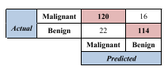
Deep learning for skin lesion diagnosis (from scratch)
“New compact deep learning model for skin cancer recognition“, by Ly et al. in 2019 [6]:
Binary classification
Balances benign and malign cases
“PHDB” dataset comprised of multiple datasets (80,192 labeled images)
Multiple custom model architectures were created
Less parameters than most approaches
Deployed app for iOS and Android
86% Accuracy
Fig 5 - Confusion Matrix [6]
Fig 6 - Feature map example [6]

Slide 6
International Skin Image Collaboration
Public dataset used as benchmark
Places a yearly challenge
ISIC 2018 part 3 top 3 winners:
Develop a classifier to distinguish between 7 classes
Top 3 submissions by Nozdryn-Plotnicki et al. (Metaoptima) [7] :
Data augmentation with preprocessing
Ensemble of multiple models trained on ImageNet (transfer learning)
AUC for best submission: ~98.3
ISIC 2019 winner:
Develop a classifier to distinguish between 9 classes
Best submition by Gessert et al. [8]:
Transfer learning from EfficientNets model pre trained on ImageNet
Preprocessing and data augmentation techniques before training
AUC from optimal ensemble: 95.4 ± 0.5

Slide 7
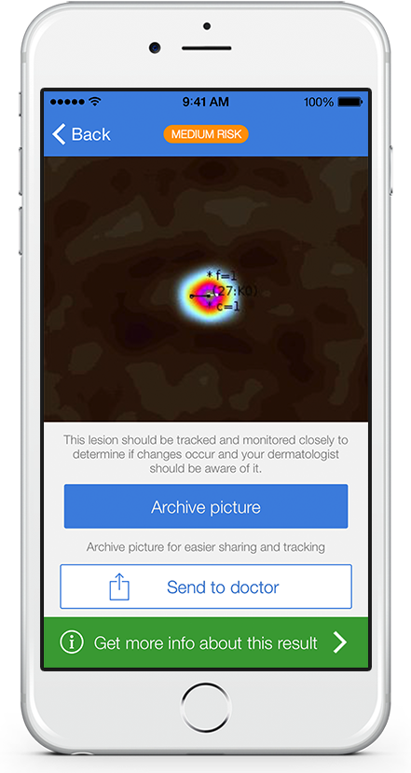
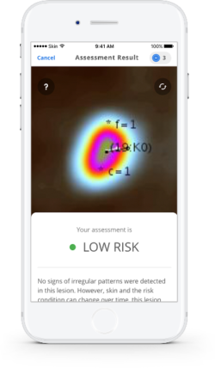
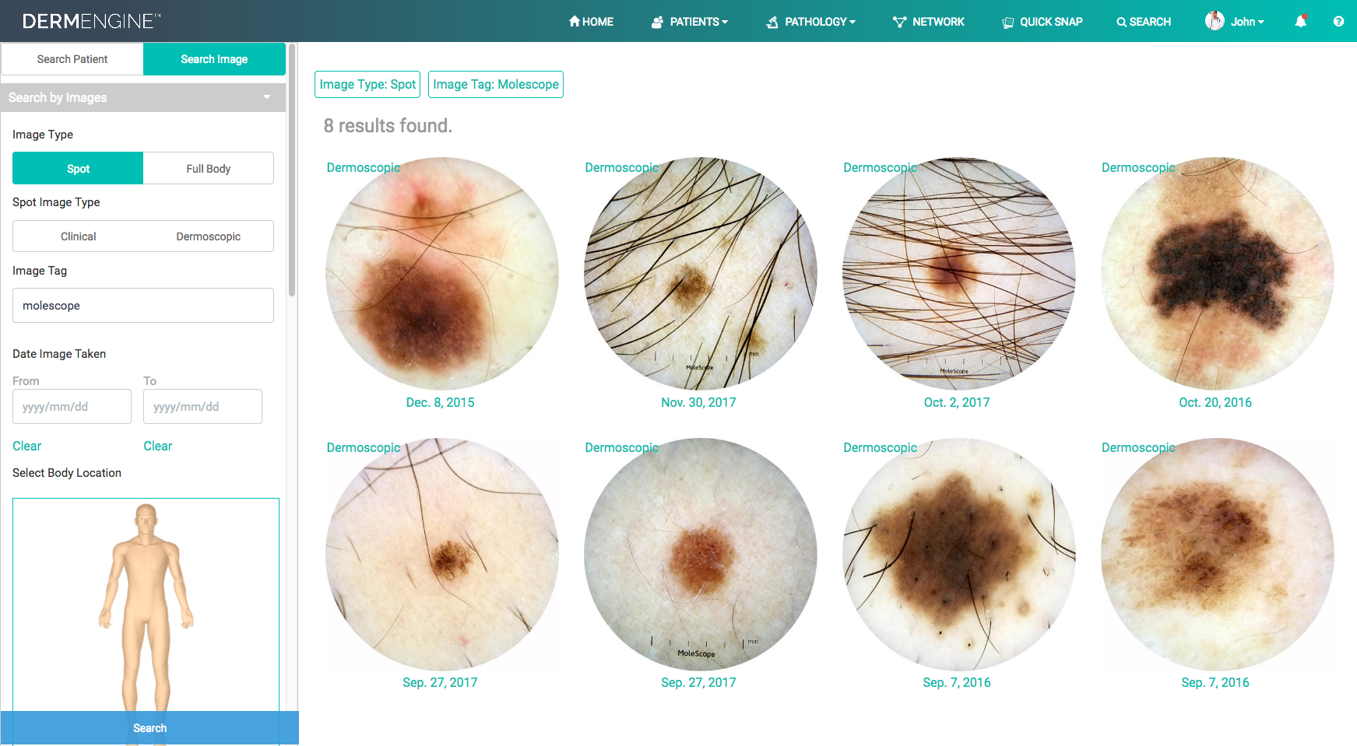
Production grade applications
Metaoptima’s Dermengine web app:
Change detection tool
Image processing such as hair removal
Visual search tool
Uses ML to compare similar lesions
Fig 8 - SkinVision mobile app[3]
Skin vision mobile app:
Patient grade mHealth app
~30 second response time
Low/Medium/High risk response
97% Sensitivity, 78% Specificity
Notifications to remind patients
Fig 7 - Demengine web app [9]

Slide 8
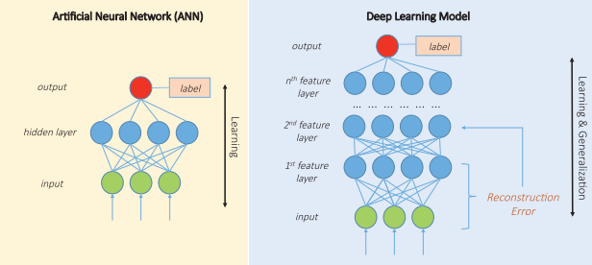
Deep learning
Implemented through artificial neural networks
Require large amounts of data and computational power
Multiple layers, each with multiple neurons
Neurons acts like a function with parameters
Parameters are learned in iterations based on a optimizer
Different architectures for different purposes: RNN’s, CNN’s, LSTM
Fig 9 - Artificial neural network [10]
Fig 10 - Deep Neural Network [10]

Slide 9

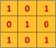
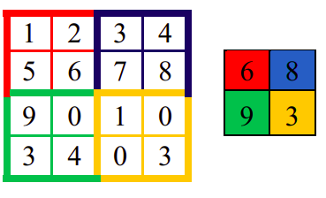
Convolutional neural networks (CNN’s/DCNN’s)
Inspired by the way that the visual cortex works
Widely used in image recognition
3 main differences from ANN’s:
Local receptive fields
Shared weights (makes it translation invariant)
Pooling layers to remove noise and reduce parameters needed
Can have multiple sets of convolutional layer + pooling layer
Fig 11 -Convolution Operation
Fig 12 - Pooling operation
Notes:
CNNs are inspired by the organization of cat’s visual cortex [85]. CNNs rely on local connections and tied weights across the units followed by feature pooling (subsampling) to obtain translation invariant descriptors [52]. The basic CNN architecture consists of one convolutional and pooling layer, optionally followed by a fully connected layer for supervised prediction. In practice, CNNs are composed by>10 convolutional and pooling layers to better model the input space. The most successful applications ofCNNs were obtained in computer vision [43, 44]. CNNs usually require a large data set of labeled documents to be properly trained.
RNNs

Slide 10


CNN’s Architectures
ImageNet dataset:
Visual dataset designed for use in visual recognition software research.
Contains more than 14 Million hand labelled images with over 20000 classes
Imagenet large scale visual recognition challenge (ILSVRC)
Fig 13- VGGNet Architecture [11]
VGGNet:
2014’s ILSVRC winner
Most common variation has 16 weight layers
Increased depth to build abstract features
ResNet (Residual neural network):
2015’s ILSVRC winner
Beats human performance on ImageNet
Less parameters than VGGNet (more lightweight)
152 layers!
Fig 14- Conventional CNN [12]

Slide 11
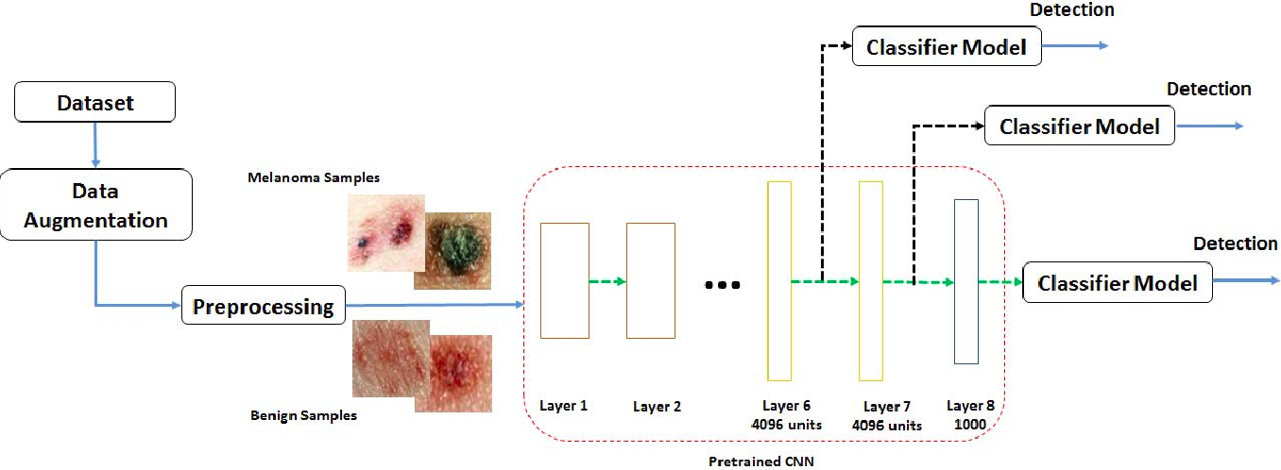
Transfer Learning
Deep networks requires large amounts of data and computational power
Method of reusing a model or knowledge for another related task
Very common technique for image recognition problems (most ISIC submissions use this approach)
Fig 14 - Transfer learning applied in skin lesion classification [13]

Slide 12
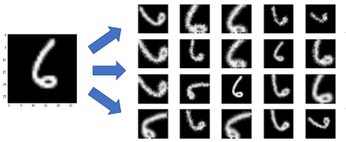
Training CNN’s: bias and variance trade off
Oftentimes, models tend to either underfit or overfit while training
Underfitting means that the model doesn’t perform well on the training data (high bias low variance)
Overfitting means that the model performs well on the training data but generalizes poorly to new data (low bias high variance)
Overfitting is very common on small datasets
One must find the best trade off between bias and variance while training
Data augmentation:
Generative models
General transformations
Fig 15 - MNIST data augmentation [14]

Slide 13
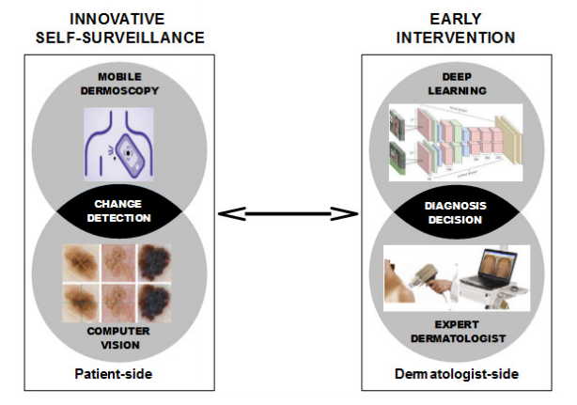
Proposed work and next steps
Develop a decision support tool for dermatologists:
Multiclass classifier to ISIC 2020
Study effects of data augmentation
Hyperparameter and model optimization
Develop a responsive eHealth app for patients and dermatologists that integrates:
Change detection tool
Decision support tool
Fig 16 - Dissertation proposed work scheme
Notes:
There’s a need for applications which provide decision support tools for skin lesion classification
CNN’s for skin lesion classification show improved performance when compared to hand crafted methods or other ML algorithms.
Techniques such as transfer learning or data augmentation help improve the model’s performance
Problems to overcome:
No pigmented skin solutions
Real world images are not “perfect”
Collaborations in order to deploy such systems

Slide 14
Conclusions
There’s a need for a decision support system to help dermatologists in the diagnosis of skin lesions
CNNs show promising results in automated skin lesion diagnosis
Techniques such as transfer learning are widely used in skin lesion diagnosis due to lack of data
Data augmentation can greatly help with the overfitting problem
Points to consider:
Deploying deep learning models into a web app requires orchestration
Influence of datasets, skin pigmentation and image quality

Slide 15
References (1)
[1] - Ali, A. A., & Al-Marzouqi, H. (2017, June 28). Melanoma detection using regular convolutional neural networks. 2017 International Conference on Electrical and Computing Technologies and Applications, ICECTA 2017. Institute of Electrical and Electronics Engineers Inc. https://doi.org/10.1109/ICECTA.2017.8252041
[2] - The Surgeon General’s Call to Action to Prevent Skin Cancer. (2014). The Surgeon General’s Call to Action to Prevent Skin Cancer. Retrieved from http://www.ncbi.nlm.nih.gov/pubmed/25320835
[3] “SkinVision | Skin Cancer Melanoma Detection App | Check Your Skin.” [Online]. Available: https://www.skinvision.com/. [Accessed: 20-Nov-2019]
[4] - Esteva, A., Kuprel, B., Novoa, R. A., Ko, J., Swetter, S. M., Blau, H. M., & Thrun, S. (2017). Dermatologist-level classification of skin cancer with deep neural networks. Nature, 542(7639), 115–118. https://doi.org/10.1038/nature21056
[5] - Haenssle, H. A., Fink, C., Schneiderbauer, R., Toberer, F., Buhl, T., Blum, A., … Zalaudek, I. (2018). Man against Machine: Diagnostic performance of a deep learning convolutional neural network for dermoscopic melanoma recognition in comparison to 58 dermatologists. Annals of Oncology. Oxford University Press. https://doi.org/10.1093/annonc/mdy166
[6] - Ly, P., Bein, D., & Verma, A. (2019, August 15). New Compact Deep Learning Model for Skin Cancer Recognition. Institute of Electrical and Electronics Engineers (IEEE). https://doi.org/10.1109/uemcon.2018.8796628
[7] - Gessert, N., Nielsen, M., Shaikh, M., Werner, R., & Schlaefer, A. (n.d.). Skin Lesion Classification Using Loss Balancing and Ensembles of Multi-Resolution EfficientNets.

Slide 16
References (2)
[8] - Nozdryn-Plotnicki, A., Yap, J., & Yolland, W. (n.d.). Ensembling Convolutional Neural Networks for Skin Cancer Classification.
[9] - “DermEngine | Visual Search.” [Online]. Available: https://www.dermengine.com/en-ca/visual-search. [Accessed: 21-Nov-2019]
[10] - R. Miotto, F. Wang, S. Wang, X. Jiang, and J. T. Dudley, “Deep learning for healthcare: Review, opportunities and challenges,” Brief. Bioinform., vol. 19, no. 6, pp. 1236–1246, May 2017.
[11] - Canziani, A., Culurciello, E., & Paszke, A. (n.d.). AN ANALYSIS OF DEEP NEURAL NETWORK MODELS FOR PRACTICAL APPLICATIONS.
[12] - Basics of the Classic CNN - Towards Data Science. (n.d.). Retrieved December 11, 2019, from https://towardsdatascience.com/basics-of-the-classic-cnn-a3dce1225add
[13] - Pomponiu, V., Nejati, H., & Cheung, N. M. (2016). Deepmole: Deep neural networks for skin mole lesion classification. In Proceedings - International Conference on Image Processing, ICIP (Vol. 2016-August, pp. 2623–2627). IEEE Computer Society. https://doi.org/10.1109/ICIP.2016.7532834
[14] - Learning to Compose Domain-Specific Transformations for Data Augmentation. (n.d.). Retrieved December 8, 2019, from https://hazyresearch.github.io/snorkel/blog/tanda.html

Slide 17
Questions?

